Slide 1
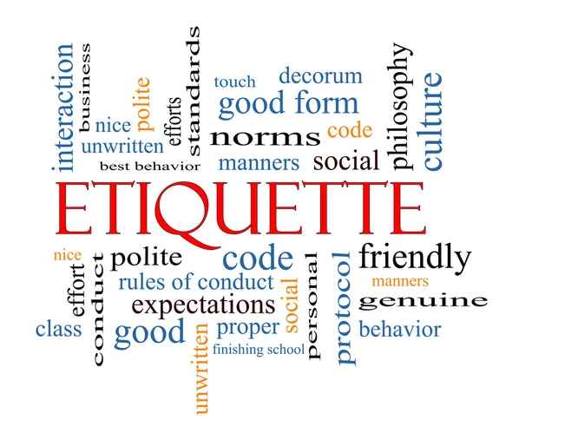
Navigating Professional Relationships: Etiquette, Professionalism, and Networking
Samudini Nagasena

Slide 2
What do we mean by ‘Etiquettes’
Etiquette refers to guidelines which control the way a responsible individual should behave in the society.
It’s about showing yourself and the people around you respect, which, believe it or not, is in quite short supply these days.
Further it refers to the various social behaviours that occur between your family, friends and colleagues or even strangers. Proper social etiquette requires following certain social norms in order to live and coexist with others in harmony. If done right, it can help you establish trust and reliance and even assist with the building of long-term relationships.

Slide 3
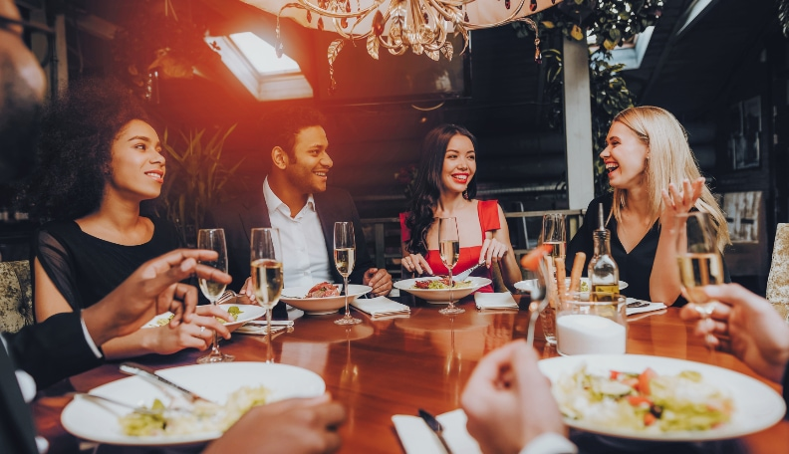
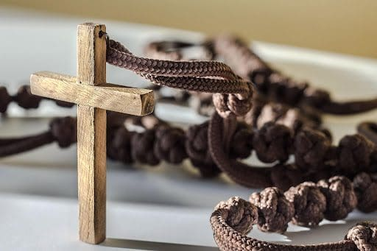
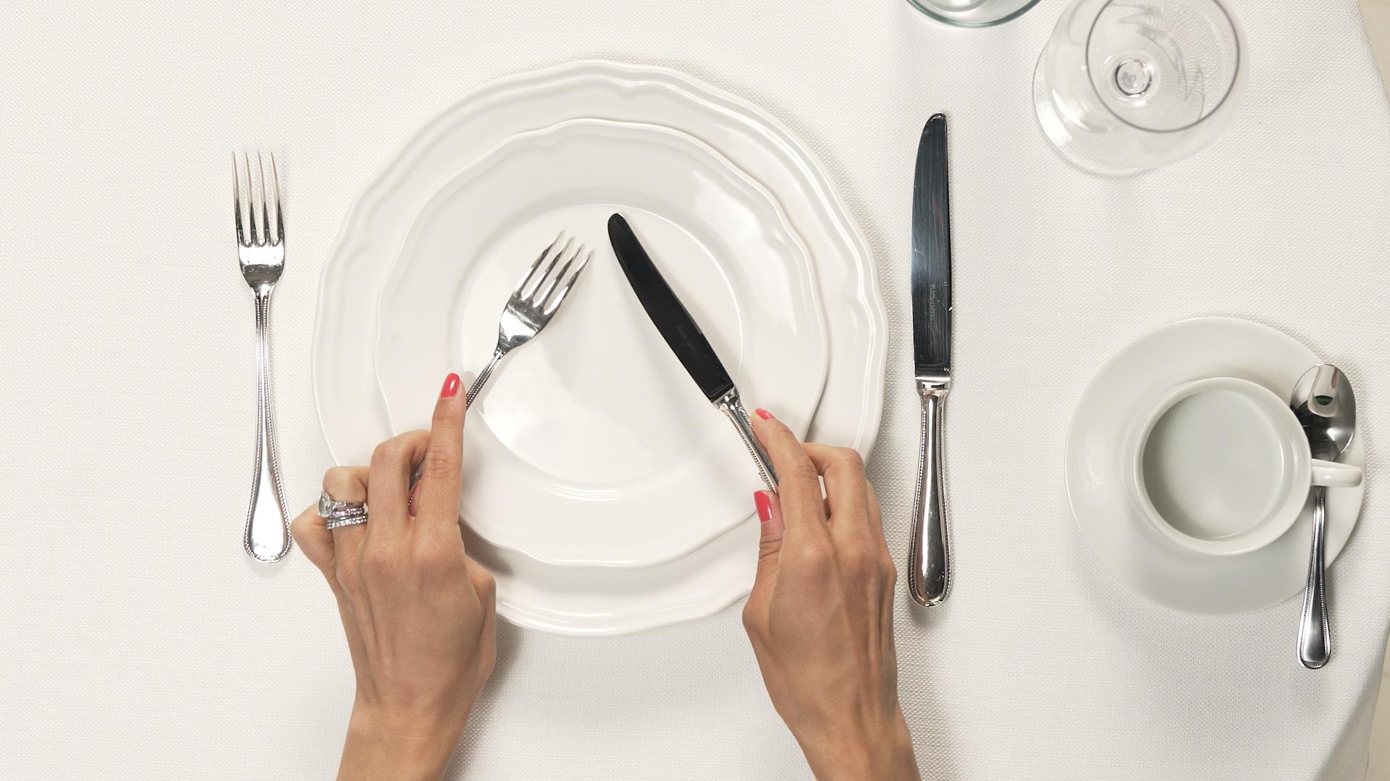


Etiquette in our daily lives
Social Etiquette
Religious Etiquette
Dining Etiquette
Telephone Etiquette
Corporate Etiquette

Slide 4
Intro to Dining Etiquettes
“Table Manners are as old as human society itself, the reason being that no human society can exist without them” - The Rituals of Dinner (1991) – Margaret Visser
While different cultures may have varying customs and traditions, there are universal do's and don'ts that apply to most dining situations. We will explore the key elements of dining etiquette, including table manners, table setting, and social etiquette.

Slide 5
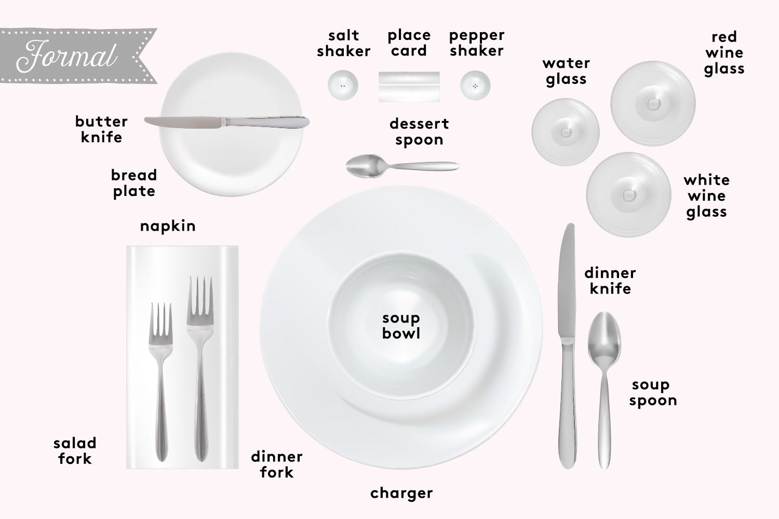
Start from the outside and work your way in

Slide 6
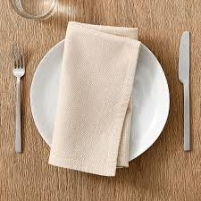
IT’S ABOUT BEING COMFORTABLE,
AND MAKING OTHERS COMFORTABLE
Rules for Napkins
Placing the napkin in your lap is the first thing you do when seated at a table. It is respectful to wait for the host or hostess to place their napkin on their lap first. The best way is to ensure you fold the napkin into a large triangle or rectangle, giving yourself several clean surfaces to work with in case you soil one side. Never crumple your napkin into a ball or wear your napkin as a bib.

Slide 7
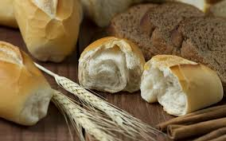
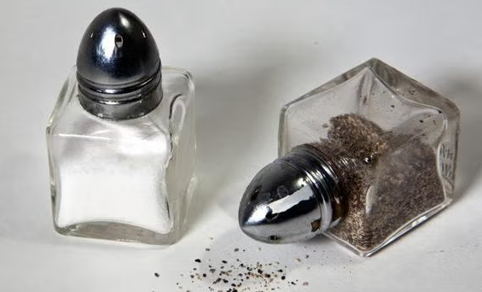
Bread slices
When eating bread, muffins or rolls, break off and eat one small piece at a time. If there is a community butter dish, take just enough for yourself and place it on your bread plate. You do not want to continually dip your bread knife into the community butter dish.
Salt & Pepper
Salt and pepper should never be separated from one another. Salt and pepper are like penguins—black and white and together for life. Even if an individual only asks for just one, always give them both.

Slide 8
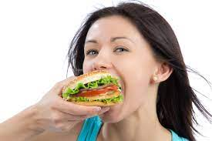
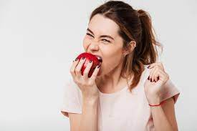
Take small bites , keep your mouth closed and finish chewing before continuing your conversation.
Try not to gulp your food , it isn't very attractive
Do not blow on food that is hot. Wait until it cools down , or eat from the side of the bowl, when having soup.

Slide 9
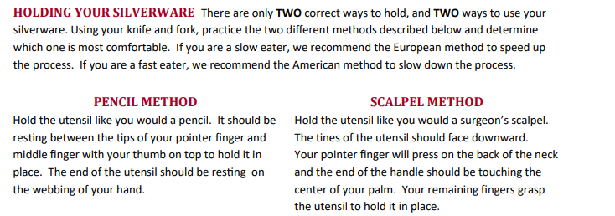
Essentials to remember….

Slide 10
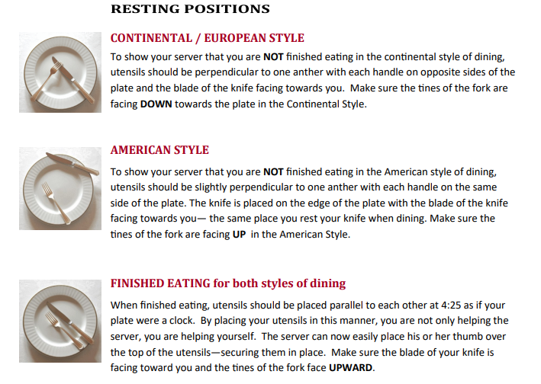

Slide 11
Social Etiquettes
Role of first impressions
Genuine smile, not a fake one
Nice warm greeting
Exude positivity and energy
Appropriate eye contact
Active listening
Dress code
Grooming
You will not get a second chance to make a first impression

Slide 12
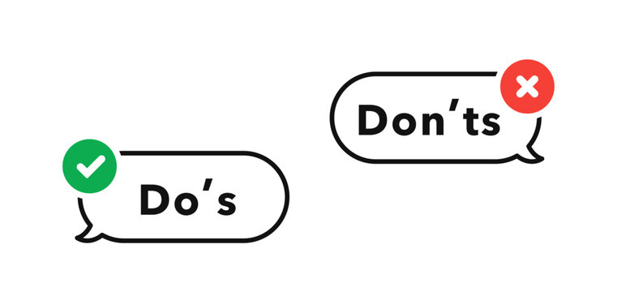
Social Etiquettes
Within 30 seconds people judge
your:
Economic level
Education level
Social position

